Slide 1

Online GYM Management System
A Comprehensive Solution for Gym Management
Submitted By:- Piyush Goel Priyanshu Raghav
Mrinal Gupta Siva Sree

Slide 2

Project Overview:
Objectives:
Enhance customer satisfaction with a user-friendly interface.
Streamline management processes for gyms and health clubs.
Key Features:
Membership Management
Booking System
The Online GYM Management System is a comprehensive web application designed to streamline gym and health club management. It offers solutions for memberships, scheduling, bookings, and customer feedback, aiming to enhance customer satisfaction and operational efficiency.

Slide 3
Implemented Modules:
User Authentication and Registration
User registration
Login mechanism
Gym Slot Scheduling Interface
Database schema for slot availability
Interface for gym slot management
Backend functionality for slot updates
Slot Availability Management
Interface for slot scheduling
Functionality for selecting preferred time slots
Backend integration for slot details
Slot Booking Information Management
Database schema for slot details
Backend functionality for scheduling and conflict prevention
Interface for viewing and managing slots
Feedback Management
Database schema for customer feedback
Functionality for providing and updating feedback
Backend logic for managing feedback securely

Slide 4
Technology Used
Technologies and Tools:
Backend:
Java: Core programming language for the application.
Spring Boot: For building robust backend services and APIs.
Frontend:
HTML: For structuring web pages.
CSS: For styling web pages.
JavaScript: For interactive features and dynamic content.
Database:
MySQL: For managing and storing user, slot, and booking data securely.
Build Tool:
Maven: For project build and dependency management..
Development Environment:
Eclipse IDE: For writing, debugging, and running the application code.
Web Server:
Tomcat: For deploying and running the web application

Slide 5
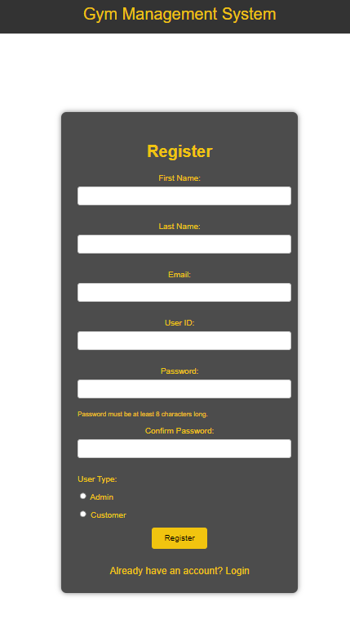
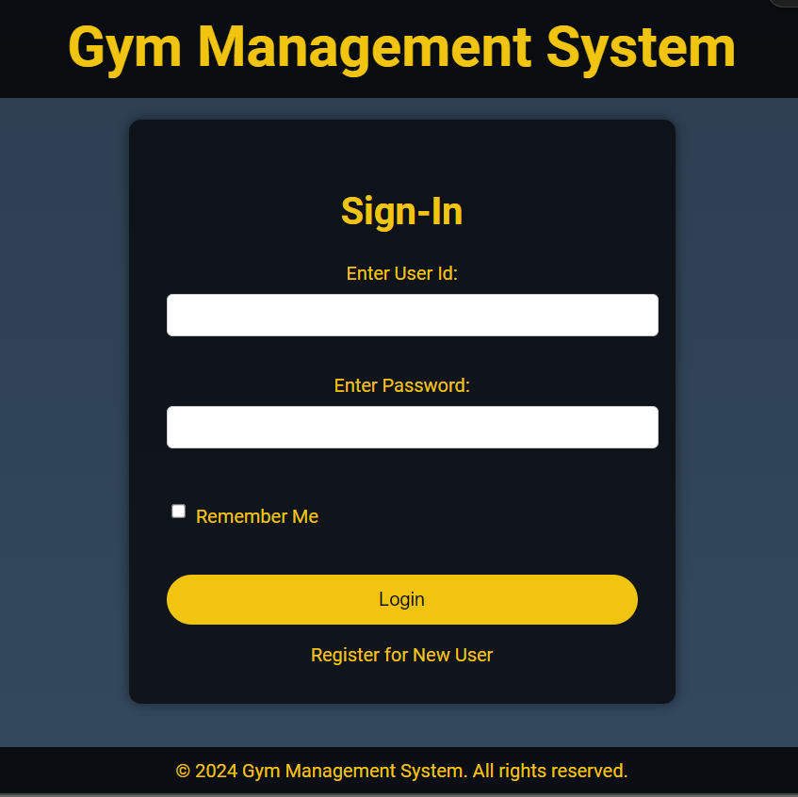
User Authentication and Registration
User Registration:
Allows new users to register.
Collects user details: first name, last name,
email, username, password.
User Login:
Secure login mechanism.

Slide 6
Backend Functionality:
Slot Management:
Competitive Service
Backend services handle the creation, updating, and deletion of slots.
The system checks for conflicts and prevents double-booking.
Integration with User Interfaces: Seamlessly integrates with both admin and customer interfaces, ensuring consistent slot information.

Slide 7

Customer Dashboard:
Features:
View and book gym slots
Provide feedback
User Experience:
Easy navigation

Slide 8
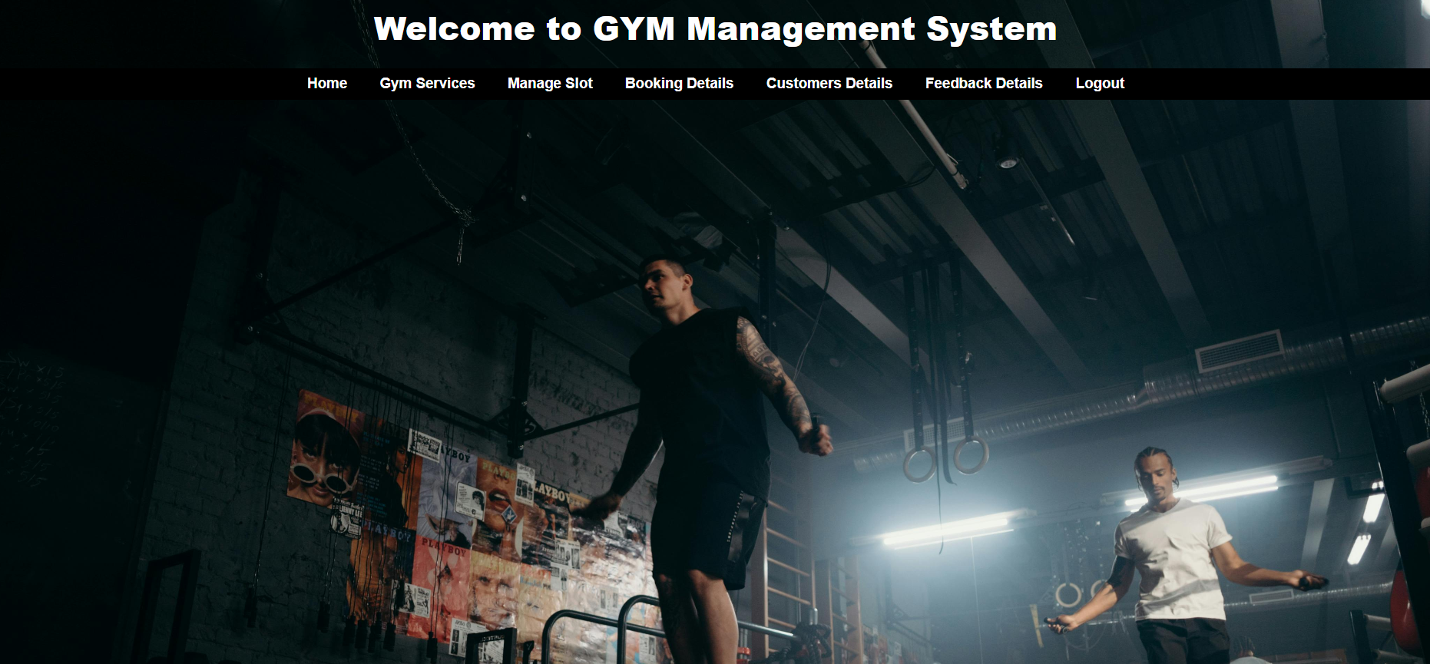
Admin Dashboard:
Features:
Manage users, gym services, and slots
Access customer feedback
User Experience:
Comprehensive management tools

Slide 9
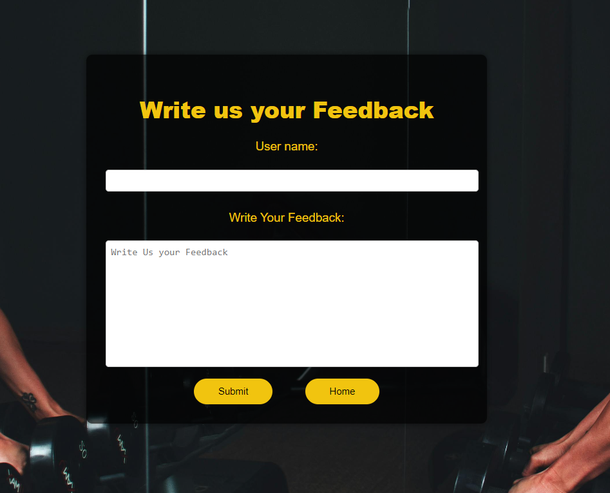
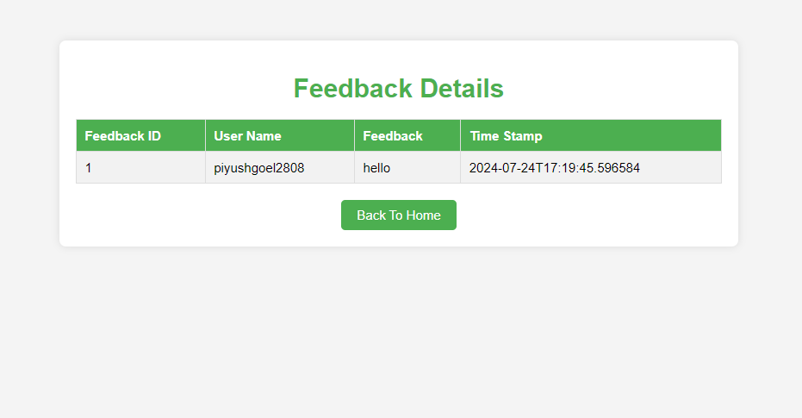
Feedback Management System
Overview:
Allows customers to provide feedback on their gym experience.
Enables the gym management to review and respond to customer feedback.
Helps in improving gym services based on customer input.
Features:
Feedback Submission:
Customers can submit feedback through a dedicated form.
Implementation:
Backend:
Developed using Java and Spring Boot.
Feedback data stored in MySQL database.
Secure data handling and storage.
Frontend:
User-friendly interface using HTML, CSS, and JavaScript.
Feedback form integrated into customer dashboard.

Slide 10

Future Work
Upcoming Enhancements:
AI-Powered Personal Training:
Integrate AI to provide personalized training recommendations
Use data analytics to enhance user experience and fitness outcomes
Advanced Analytics and Reporting:
Develop advanced reporting tools for admin insights
Implement predictive analytics to optimize slot availability and usage
Enhanced Security Measures:
Strengthen data protection and user privacy
Implement multi-factor authentication and encryption
Community Features:
Introduce forums and groups for member interaction
Organize virtual fitness events and challenges
Integration with Wearable Devices:
Sync with fitness trackers and smartwatches
Provide real-time health and fitness data to users and trainers

Slide 11


Thank You
Piyush Goel
Priyanshu Raghav
Mrinal Gupta
Siva Sree

